Slide 1
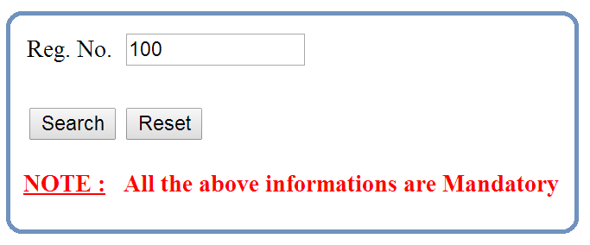

Slide 2
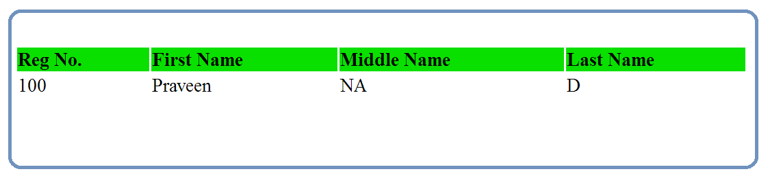


Slide 3
Java
JDBC
Driver
DB

Slide 4
Get
Reg. No. information via
Command Line Arguments
Java
JDBC
Driver
DB
1. Load the Driver
2. Get the DB Connection via Driver
3. Issue SQL Queries via Connection
select * from students_info
where regno = ?
4. Process the Results
Print Data / Error Message
5. Close All JDBC Objects

